Slide 1

#LifeKoKaroLift
Java
Program
<number>
06/01/2021

Slide 2



Course : Java Program
Lecture On : Functions & Errors
Instructor : Rahul Kumar
06/01/2021
<number>

Slide 3
Today’s Agenda
1.) Functions
2.) Create functions to make your program efficient
3.) Inbuilt Methods
4.) Errors
06/01/2021
Java Program
<number>
Notes:
<number>

Slide 4
Functions
Java Methods/Functions
A method is a block of code which only runs when it is called.
You can pass data, known as parameters, into a method.
Methods are used to perform certain actions, and they are also known as functions.
Why use methods?
To reuse code: define the code once, and use it many times.
Create a Method
A method must be declared within a class. It is defined with the name of the method, followed by parentheses (). Java provides some pre-defined methods, such as System.out.println(), but you can also create your own methods to perform certain actions:
06/01/2021
<number>

Slide 5
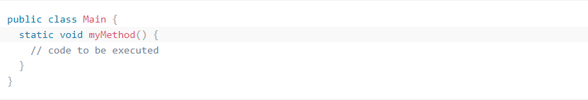
Functions
Create a method inside Main:
Example Explained
myMethod() is the name of the method
static means that the method belongs to the Main class and not an object of the Main class.
void means that this method does not have a return value.
06/01/2021
<number>

Slide 6
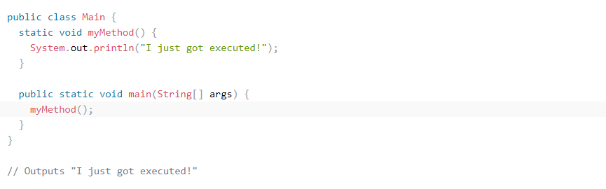
Functions
Call a Method
To call a method in Java, write the method's name followed by two parentheses () and a semicolon;
In the following example, myMethod() is used to print a text (the action), when it is called:
Example
Inside main, call the myMethod() method:
06/01/2021
<number>

Slide 7
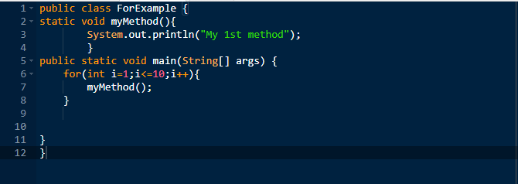
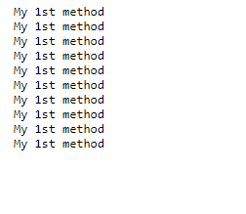
Functions
Use loops to reduce the repetition of logic
Here we have just 1 System.out.println("My 1st method"); inside function so whenever we call the function we will print "My 1st method“ . This is how we use loops and reduce the repetition of logic.
06/01/2021
<number>

Slide 8
Functions
Create functions to make your program efficient
We can use functions to make our program efficient . There are many ways to do so some of them we will discuss
Inbuilt Functions in Java
These are some predefined functions in Java which have some internal code which helps to perform certain tasks and helps us save time.
Let us see some inbuilt functions one by one.
06/01/2021
<number>

Slide 9
Functions
System.out.print()
// inbuilt function to print
String abc = “Hello”;
abc.length()
// length() is the inbuilt function which provides // the length of the string
int abs = Math.abs(-9)
// Math is the library and abs() is the function. // It returns the absolute value of a number. Here,
// it will return 9 which will be stored in abs.
06/01/2021
<number>

Slide 10
Functions
System.out.print(Math.max(a,b));
// max() function will return the bigger value
// between a & b.
String string1 = “hero”;
Boolean a = string1.equals(“Hero”);
// equals() function compares two string values
// and returns a boolean answer. Here it will
// return false as “hero” & “Hero” are different.
06/01/2021
<number>

Slide 11
Functions
String string1 = “hero”;
String string2 = “honda”;
String string3 = string1.concat(string2);
// concat() function returns the concatenated
// value of first string with the second string.
// Here, it will return “herohonda” which is
// further stored in string3.
06/01/2021
<number>

Slide 12
Functions
String string1 = “hero”;
String string2 = “honda”;
String string3 = string1.concat(string2);
// concat() function returns the concatenated
// value of first string with the second string.
// Here, it will return “herohonda” which is
// further stored in string3.
06/01/2021
<number>

Slide 13
Handle errors
Java Exceptions
When executing Java code, different errors can occur: coding errors made by the programmer, errors due to wrong input, or other unforeseeable things.
When an error occurs, Java will normally stop and generate an error message. The technical term for this is: Java will throw an exception (throw an error).
Java try and catch
The try statement allows you to define a block of code to be tested for errors while it is being executed.
The catch statement allows you to define a block of code to be executed, if an error occurs in the try block.
The try and catch keywords come in pairs:
06/01/2021
<number>

Slide 14
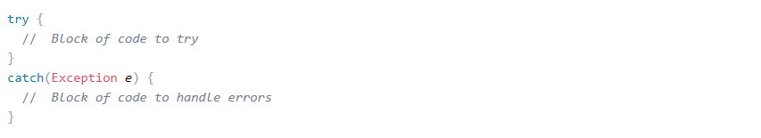
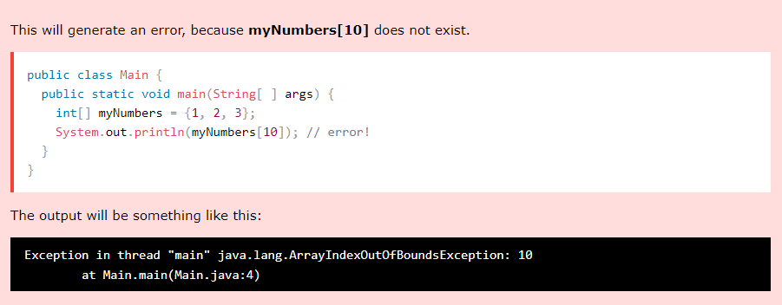
Handle errors
Syntax
Consider the following example:
06/01/2021
<number>

Slide 15
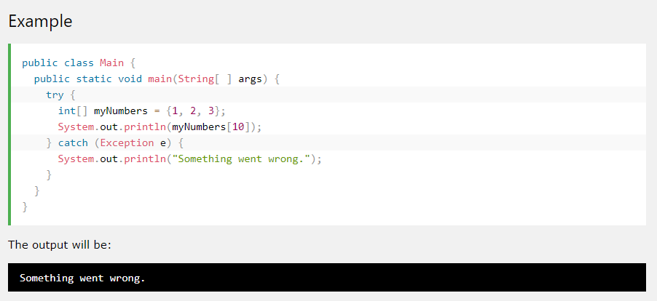
Handle errors
If an error occurs, we can use try...catch to catch the error and execute some code to handle it:
06/01/2021
<number>

Slide 16
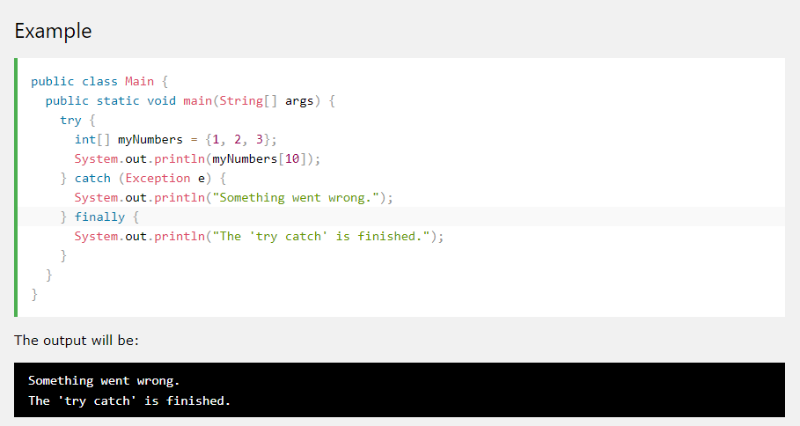
Handle errors
Finally
The finally statement lets you execute code, after try...catch, regardless of the result:
06/01/2021
<number>

Slide 17
Lambda Expressions
Java Lambda Expressions
Lambda Expressions were added in Java 8.
A lambda expression is a short block of code which takes in parameters and returns a value. Lambda expressions are similar to methods, but they do not need a name and they can be implemented right in the body of a method.
Syntax
The simplest lambda expression contains a single parameter and an expression:
parameter -> expression
To use more than one parameter, wrap them in parentheses:
(parameter1, parameter2) -> expression
Expressions are limited. They have to immediately return a value, and they cannot contain variables, assignments or statements such as if or for. In order to do more complex operations, a code block can be used with curly braces. If the lambda expression needs to return a value, then the code block should have a return statement.
(parameter1, parameter2) -> { code block }
06/01/2021
<number>

Slide 18
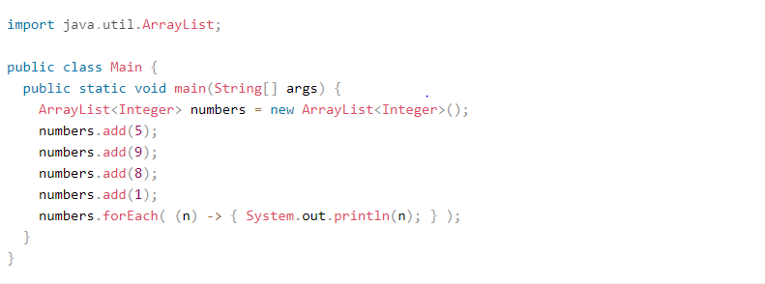
Lambda Expressions
Using Lambda Expressions
Lambda expressions are usually passed as parameters to a function:
Example
Use a lamba expression in the ArrayList's forEach() method to print every item in the list:
06/01/2021
<number>

Slide 19
#LifeKoKaroLift
Thank You!
<number>
06/01/2021

